Slide 1
“Come Bond With Us” Astor West Urban Renewal Area Expansion Proposal
Astoria Development Commission
August 1, 2016

Slide 2
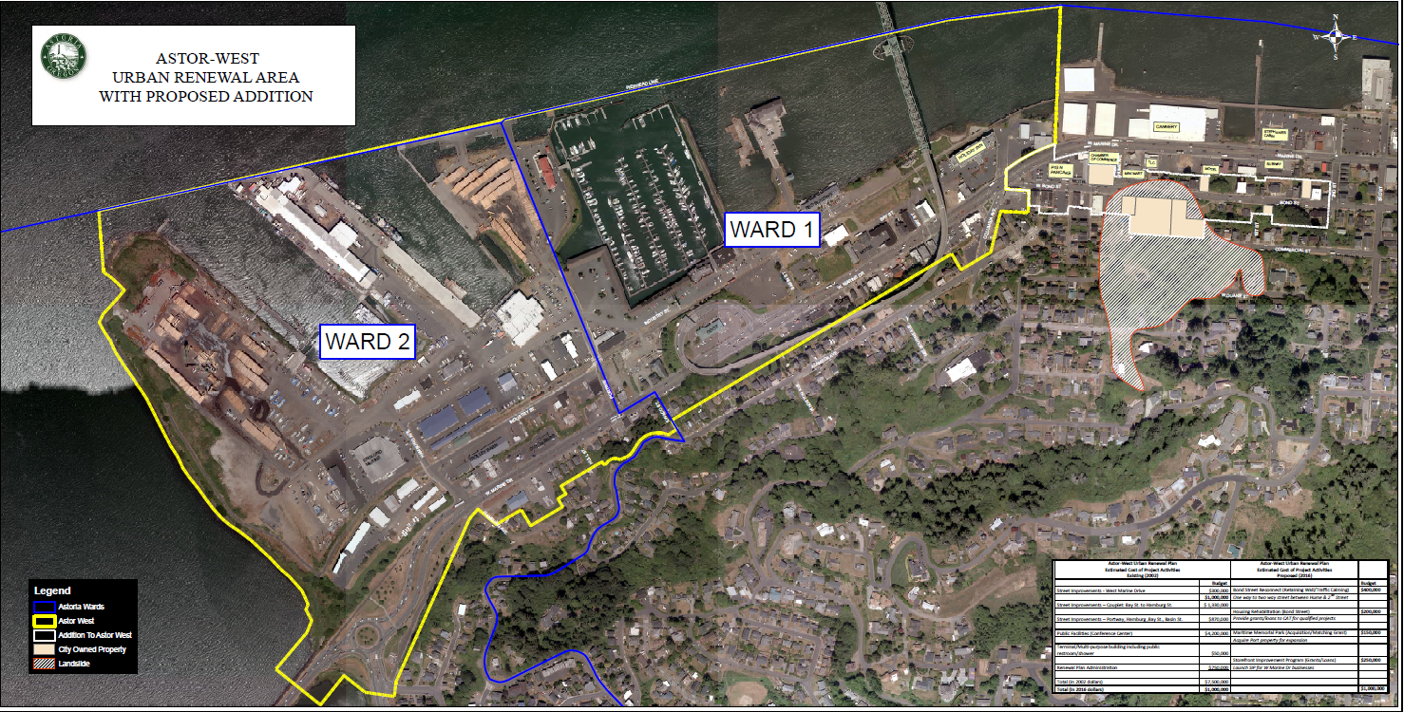

Slide 3
What did we hear?
24 people signed in
Concerns from residents about reopening Bond Street – traffic speed, noise, etc
Support for improvements to street and local housing
When is it going to happen?
What’s in it for me?

Slide 4
Potential Projects
Project | Planned Expenditures | Notes
Bond St Retaining Wall | $400,000 | Includes limited funds for traffic calming
Housing Rehab | $200,000 | Partner with CCA or CAT on housing grant/loan program
Storefront Improvement Program | $250,000 | Launch SIP in Fall 2016 ADC Update: Aug 15

Slide 5
Next Steps
Continue outreach to business/property owners about opportunities
Initiate plan amendment study – August 15
Polish storefront program guidelines, bring back to ADC – August 15
Send required public notice in August
Present “URA Plan & Report” to APC on October 25 and ADC on November 7

